Slide 1
Simple linear regression
Santosh Chhatkuli

Slide 2
Introduction
Simple linear regression is a statistical method used to model the relationship between two continuous variables i.e. dependent variable Y (the variable we want to predict or explain) and independent variable X (the variable used to make predictions)
Simple linear regression assumes that the relationship between the dependent variable (or response variable or explained variable) and independent variable (or regressor or predictor or explanator) is represented by a straight line.
Simple linear regression aims to find a linear equation that best describes how changes in the independent variable are associated with changes in the dependent variable
Ultimate aim of simple linear regression is to predict the value of dependent variable for know value of independent variable (prediction)

Slide 3
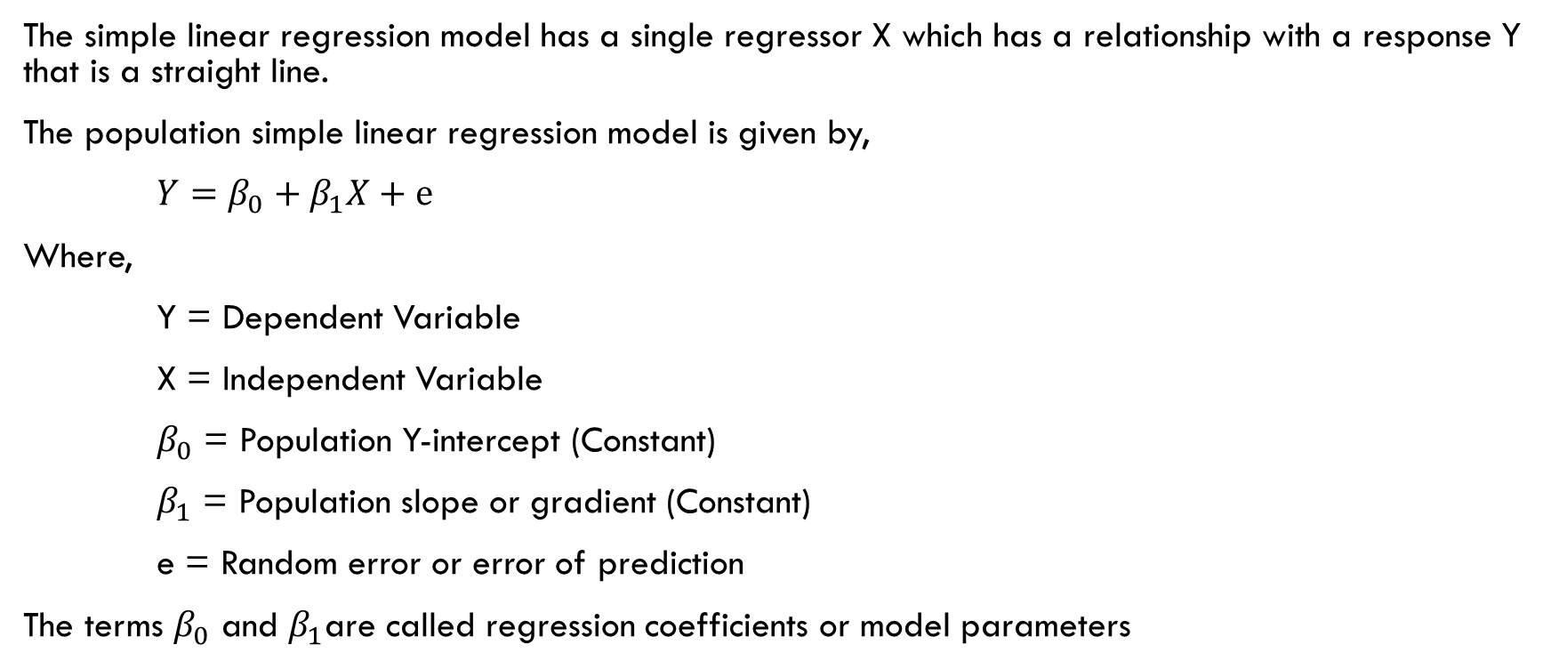
Simple Linear Regression Model
The simple linear regression model has a single regressor X which has a relationship with a response Y that is a straight line.
The population simple linear regression model is given by,
$Y=β_{0}+β_{1}X+e$
Where,
Y = Dependent Variable
X = Independent Variable
$β_{0}$ = Population Y-intercept (Constant)
$β_{1}$ = Population slope or gradient (Constant)
e = Random error or error of prediction
The terms $β_{0}$ and $β_{1}$are called regression coefficients or model parameters

Slide 4
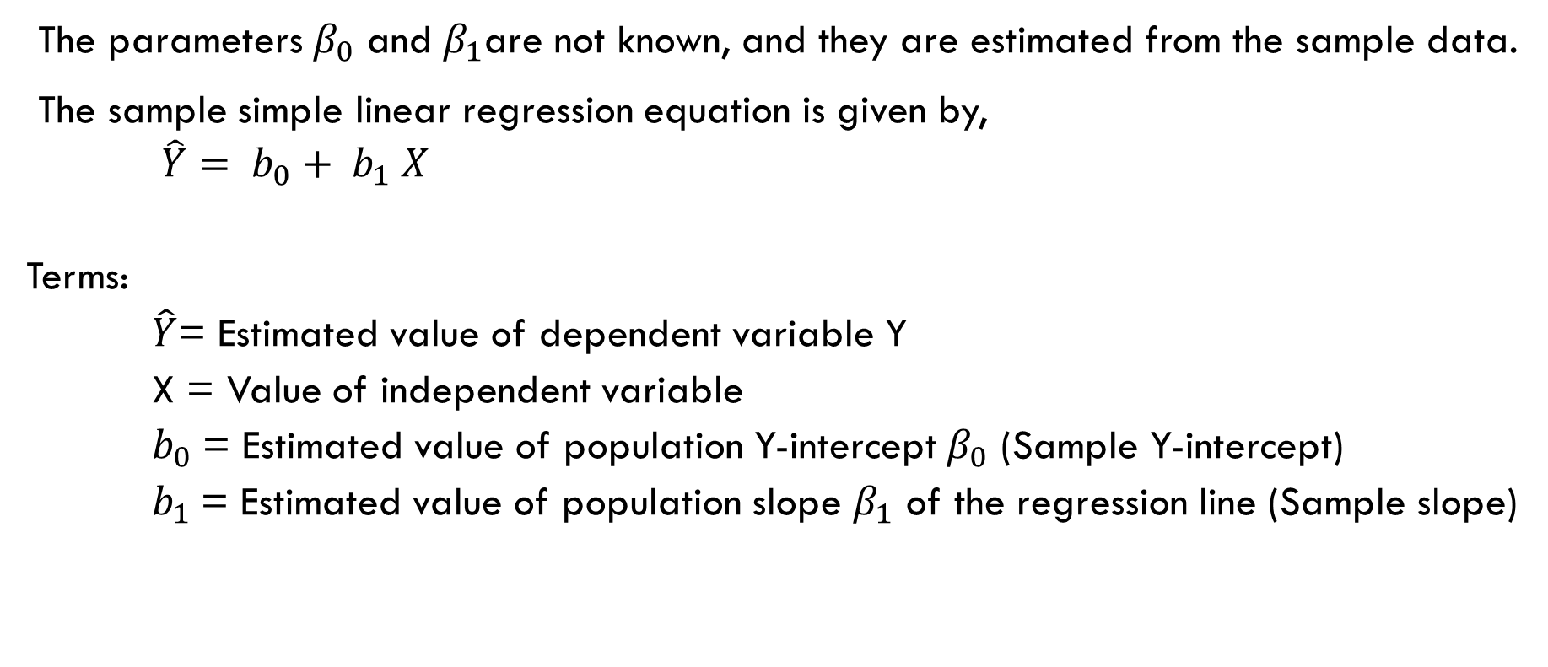
Simple linear regression equation
The parameters $β_{0}$ and $β_{1}$are not known, and they are estimated from the sample data.
The sample simple linear regression equation is given by,
$\hat{Y}= b_{0}+ b_{1} X$
Terms:
$\hat{Y}$= Estimated value of dependent variable Y
X = Value of independent variable
$b_{0}$= Estimated value of population Y-intercept $β_{0}$ (Sample Y-intercept)
$b_{1}$= Estimated value of population slope $β_{1}$ of the regression line (Sample slope)

Slide 5
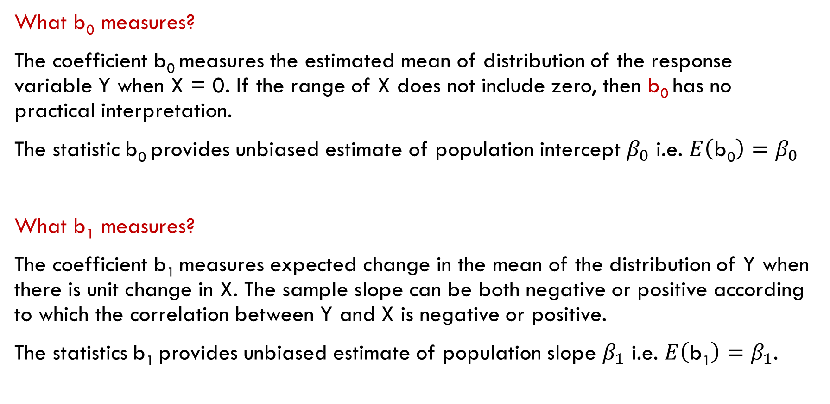
Interpretation of sample coefficients
What b₀ measures?
The coefficient b₀ measures the estimated mean of distribution of the response variable Y when X = 0. If the range of X does not include zero, then b₀ has no practical interpretation.
The statistic b₀ provides unbiased estimate of population intercept $β_{0}$ i.e. $E\left(\text{b}\text{0}\right)=β_{0}$
What b₁ measures?
The coefficient b₁ measures expected change in the mean of the distribution of Y when there is unit change in X. The sample slope can be both negative or positive according to which the correlation between Y and X is negative or positive.
The statistics b₁ provides unbiased estimate of population slope $β_{1}$ i.e. $E\left(\text{b}\text{1}\right)=β_{1}$.

Slide 6
Assumption of simple linear regression
Simple linear regression is only appropriate if it satisfies certain conditions. The classical linear regression model has very stringent rules.
Linearity: The relationship between the predictor (independent variable, 𝑋) and the outcome (dependent variable, 𝑌) is linear. This means that changes in 𝑋 lead to proportional changes in 𝑌)
Normality of Errors: The residuals (differences between observed Y and predicted Y values) are normally distributed. This assumption is especially important for conducting hypothesis tests and constructing confidence intervals.
Homoscedasticity: The variance of the residuals (errors) is constant across all levels of the independent variable. This means that the spread of the residuals should be roughly the same for all values of 𝑋.
Independent of errors: (usually specific to time series data): The errors (residuals) associated with each observation should be independent of each other. The residuals should not show any patterns when plotted over time; they should be random. There should be no correlation between residuals (In a cross-sectional dataset, Point 4 is often not relevant)

Slide 7
Methods for estimating regression coefficients
The various methods of estimating regression coefficients are:
Ordinary Least Squares (OLS) estimator of regression coefficients
Maximum Likelihood estimation (MLE) of regression coefficients
Bayesian Estimation
Weighted Least Square (WLS) esimation

Slide 8
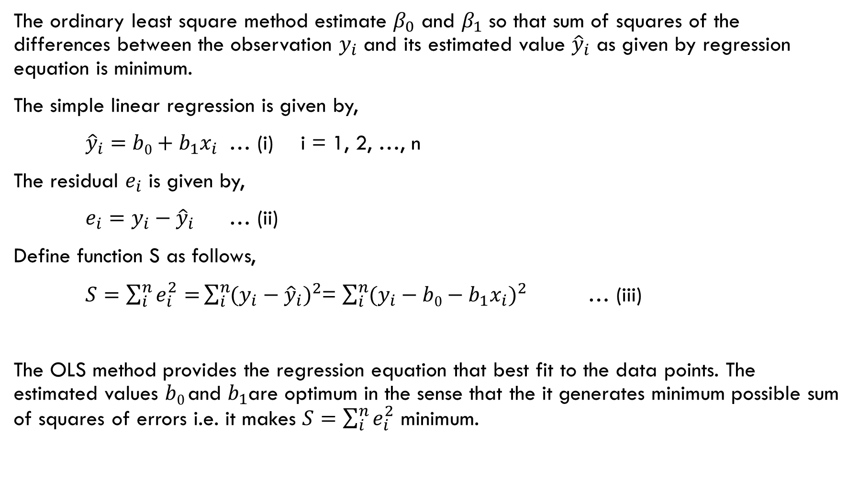
Ordinary Least Square Method
The ordinary least square method estimate $β_{0}$ and $β_{1}$ so that sum of squares of the differences between the observation $y_{i}$ and its estimated value ${\hat{y}}_{i}$ as given by regression equation is minimum.
The simple linear regression is given by,
${\hat{y}}_{i}=b0+b_{1}x_{i}$ … (i) i = 1, 2, …, n
The residual $e_{i}$ is given by,
$e_{i}=y_{i}−{\hat{y}}_{i}$ … (ii)
Define function S as follows,
$S=\sum_{i}^{n}{e_{i}^{2}=}\sum_{i}^{n}{{(y_{i}−{\hat{y}}_{i})}^{2}}$= $\sum_{i}^{n}{{(y_{i}−b0−b_{1}x_{i})}^{2}}$ … (iii)
The OLS method provides the regression equation that best fit to the data points. The estimated values $b0$and $b_{1}$are optimum in the sense that the it generates minimum possible sum of squares of errors i.e. it makes $S=\sum_{i}^{n}{e_{i}^{2}}$ minimum.

Slide 9

The least square estimator of β0 and β1 must satisfy following:
$\frac{∂S}{∂b_{0}}$ = 0 and $\frac{∂S}{∂b_{1}}$ = 0
Differentiating S function partially with respect to b₀ we get
$\frac{∂S}{∂b_{0}}$ = 0
Or, $\frac{∂\left\{\sum_{i}^{n}{{(y_{i}−b0−b_{1}x_{i})}^{2}}\right\}}{∂b_{0}}$ = 0
…
Or, $\sum_{i}^{n}{y_{i}}$ = $n b_{0}$ + $b_{1}$ $\sum_{i}^{n}{x_{i}}$
Similarly differentiating S function partially with respect to b₁ we get
$\frac{∂S}{∂b_{1}}$ = 0
Or, $\frac{∂\left\{\sum_{i}^{n}{{(y_{i}−b0−b_{1}x_{i})}^{2}}\right\}}{∂1}$ = 0
…
Or, $\sum_{i}^{n}{y_{i}x_{i}}$ = $b_{0}\sum_{i}^{n}{x_{i}}$ + $b_{1}\sum_{i}^{n}{x_{i}^{2}}$

Slide 10
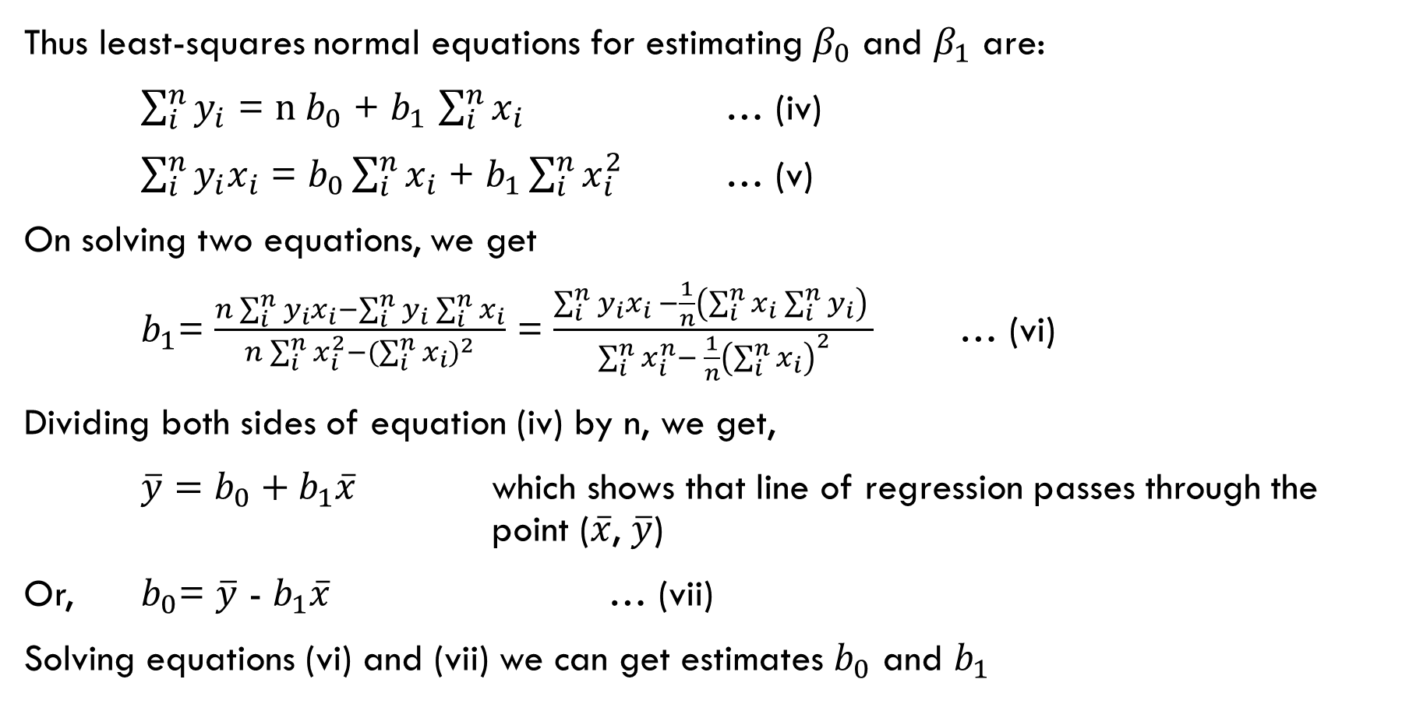
Thus least-squares normal equations for estimating $β_{0}$ and $β_{1}$ are:
$\sum_{i}^{n}{y_{i}}$ = $n b_{0}$ + $b_{1}$ $\sum_{i}^{n}{x_{i}}$ … (iv)
$\sum_{i}^{n}{y_{i}x_{i}}$ = $b_{0}\sum_{i}^{n}{x_{i}}$ + $b_{1}\sum_{i}^{n}{x_{i}^{2}}$ … (v)
On solving two equations, we get
$b_{1}$= $\frac{n\sum_{i}^{n}{y_{i}}x_{i}−\sum_{i}^{n}{y_{i}\sum_{i}^{n}{x_{i}}}}{n\sum_{i}^{n}{x_{i}^{2}}−({\sum_{i}^{n}{x_{i}})}^{2}}$ = $\frac{\sum_{i}^{n}{y_{i}x_{i} −\frac{1}{n}\left(\sum_{i}^{n}{x_{i}\sum_{i}^{n}{y_{i}}}\right) }}{\sum_{i}^{n}{x_{i}^{n}}− \frac{1}{n}{\left(\sum_{i}^{n}{x_{i}}\right)}^{2}}$ … (vi)
Dividing both sides of equation (iv) by n, we get,
$\overline{y}=b_{0}+b_{1}\overline{x}$ which shows that line of regression passes through the point ($\overline{x}$, $\overline{y}$)
Or, $b_{0}$= $\overline{y}$ - $b_{1}\overline{x}$ … (vii)
Solving equations (vi) and (vii) we can get estimates $b_{0}$ and $b_{1}$

Slide 11
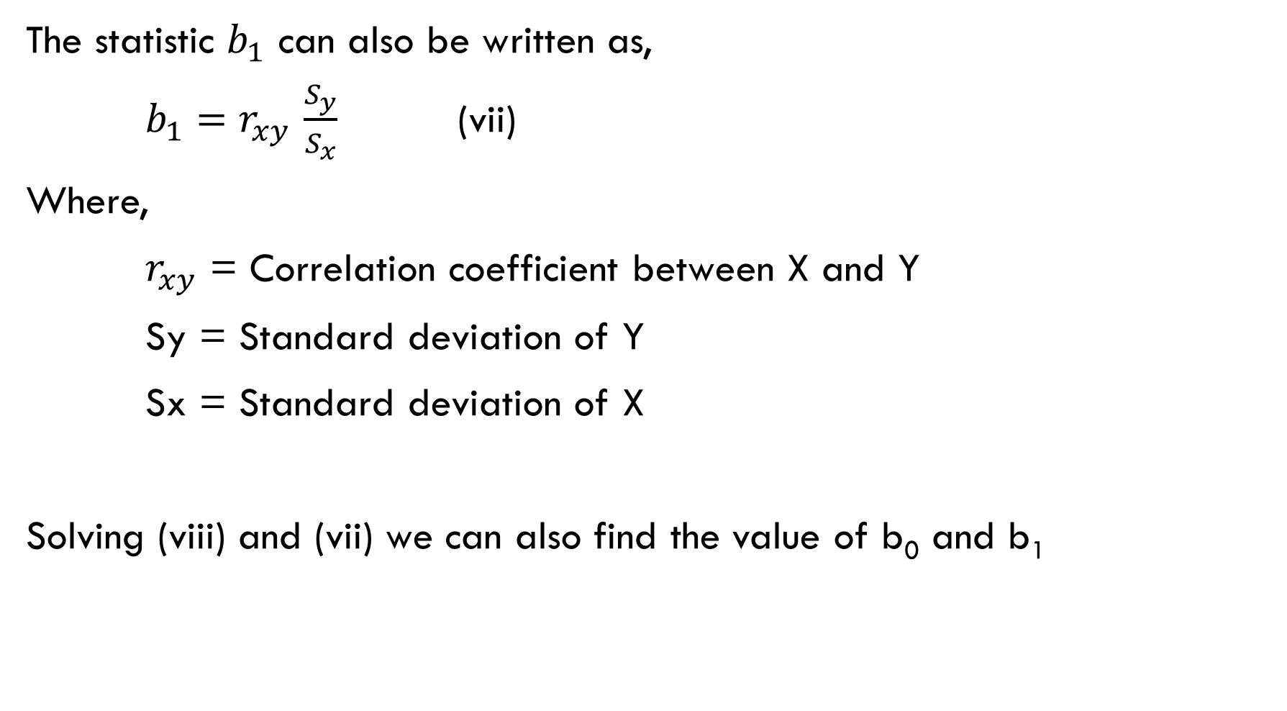
The statistic $b_{1}$ can also be written as,
$b_{1}$ ${=r}_{xy}\frac{S_{y}}{S_{x}}$ (vii)
Where,
$r_{xy}$ = Correlation coefficient between X and Y
Sy = Standard deviation of Y
Sx = Standard deviation of X
Solving (viii) and (vii) we can also find the value of b₀ and b₁

Slide 12
Regression equation of x on y
The regression equation of X on Y is the equation that predicts the values of X based on the values of Y. Generally, we predict values of Y using values of X. But in some relationship, we use regression equation of X on Y.
Reasons:
If you have a system or process where you can control the output (Y) and want to determine the necessary input (X) to achieve that output, the regression equation of X on Y is useful. If salesperson is given some sales target, we can predict minimum test score required by salesperson in ordered to achieve that sales target.
If you have a variable (X) that is difficult or expensive to measure directly, you might be able to use a more easily measured variable (Y) that is correlated with X.
In case of associative relationship, we can use both regression of Y on X and X on Y. For example, we can predict height of husband using height of wife or we can predict height of wife using height of husband.

Slide 13
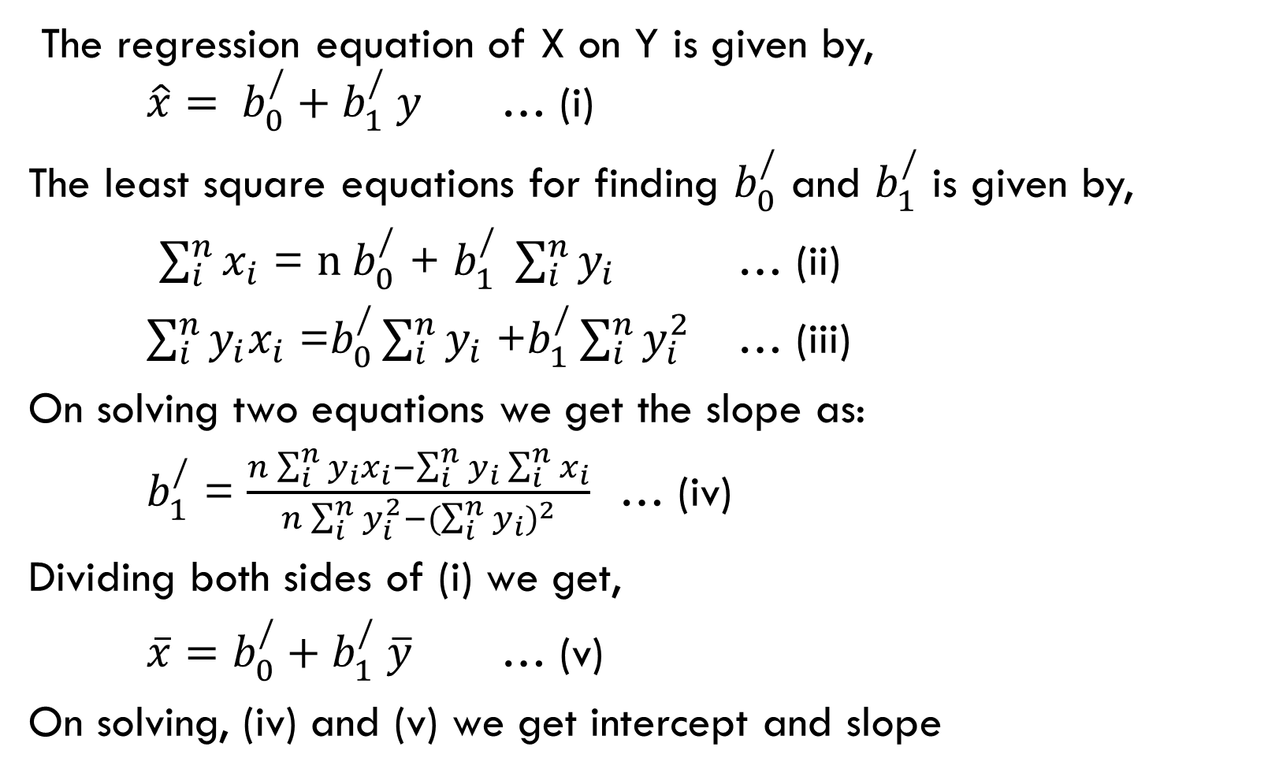
The regression equation of X on Y is given by,
$\hat{x}= b_{0}^{/}+b_{1}^{/} y$ … (i)
The least square equations for finding $b_{0}^{/}$ and $b_{1}^{/}$ is given by,
$\sum_{i}^{n}{x_{i}}$ = $n b_{0}^{/}$ + $b_{1}^{/} \sum_{i}^{n}{y_{i}}$ … (ii)
$\sum_{i}^{n}{y_{i}x_{i}}$ =$b_{0}^{/}\sum_{i}^{n}{y_{i}}$ +$b_{1}^{/}\sum_{i}^{n}{y_{i}^{2}}$ … (iii)
On solving two equations we get the slope as:
$b_{1}^{/}$ = $\frac{n\sum_{i}^{n}{y_{i}}x_{i}−\sum_{i}^{n}{y_{i}\sum_{i}^{n}{x_{i}}}}{n\sum_{i}^{n}{y_{i}^{2}}−({\sum_{i}^{n}{y_{i}})}^{2}}$ … (iv)
Dividing both sides of (i) we get,
$\overline{x}=b_{0}^{/}+b_{1}^{/} \overline{y}$ … (v)
On solving, (iv) and (v) we get intercept and slope

Slide 14
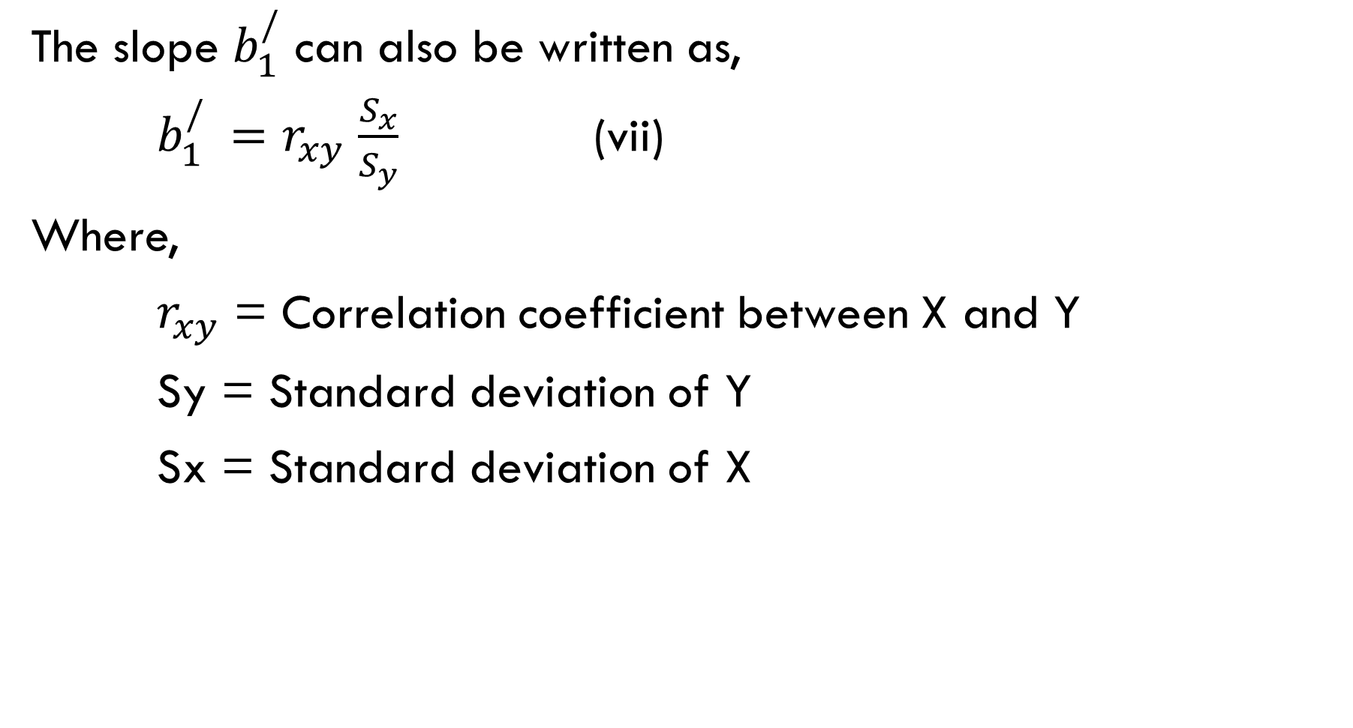
The slope $b_{1}^{/}$ can also be written as,
$b_{1}^{/} {=r}_{xy}\frac{S_{x}}{S_{y}}$ (vii)
Where,
$r_{xy}$ = Correlation coefficient between X and Y
Sy = Standard deviation of Y
Sx = Standard deviation of X

Slide 15
A random sample of eight drivers insured with a company and having similar minimum required auto insurance policies was selected. The following lists their driving experiences (in years) and monthly auto insurance premium (in rupees)
What is dependent and independent variable in this case. Justify it.
Draw a scatter diagram of these two variables. What is the strength and type of relationship existing between two variables.
Does simple linear regression model seem plausible for this data?
Fit the least square regression line by taking driving experience as independent variable and monthly auto-insurance premium as dependent variable.
Interpret meaning of values of b0 and b1
Predict the monthly auto insurance premium for a driver with 10 years of driving experience.
Person | 1 | 2 | 3 | 4 | 5 | 6 | 7 | 8
Driving experience (in yrs) | 5 | 2 | 12 | 9 | 15 | 6 | 25 | 16
Premium (in 1000 rs) | 6.4 | 8.7 | 5.0 | 7.1 | 4.4 | 5.6 | 4.2 | 6.0

Slide 16
Numerical example
The scores of a sample of students on entrance examination and cumulative grade point average (GPA) at graduation is given below:
Fit a regression equation of Entrance score on CGPA
Comment on the value of regression coefficient
Estimate the CGPA of a student who scored 80 on the entrance exam
Student | A | B | C | D | E | F | G | H | I
Entrance Score | 74 | 69 | 85 | 63 | 82 | 60 | 79 | 91 | 99
CGPA | 2.6 | 2.2 | 3.4 | 2.3 | 3.1 | 2.1 | 3.2 | 3.8 | 4.0

Slide 17
Computing regression coefficients in bivariate frequency distribution

